Slide 1
WILL IT SELL ? Your own app success predictor…….
TEAM 27:
Shreyam Kela
Sayalee Shankar Bhusari
Harsh Agrawal
Vaishali Koul

Slide 2


MOTIVATION
More than 50 percent of apps fail within the first 4 years of their release.
Ideas that might seem like a potential success at the beginning might turn out to be a huge fail after their release.
Proper market research is the key to ensure an app’s success.
.

Slide 3
THE PREDICTION SYSTEM
- Based on Logic and Analytics.
- Compares apps with a similar description.
- Weighted average of the features in similar apps is the prediction output for the new app.

Slide 4
IMPLEMENTATION
- Tokenize and Vectorize the descriptions to build Vocabulary
- Transform each description into a sparse array
- Determine the Cosine Similarity for the new description

Slide 5
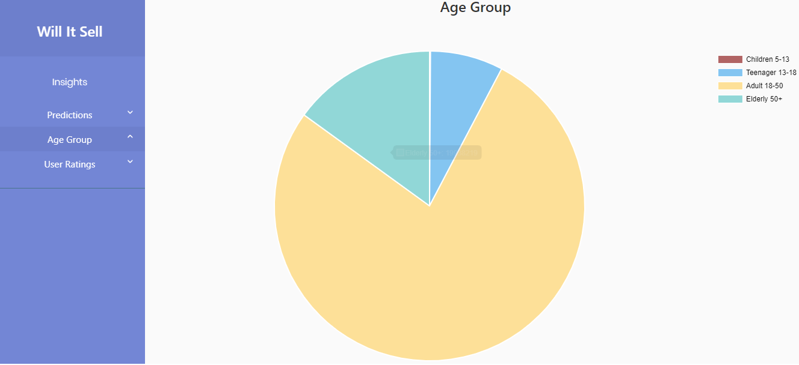
INSIGHTS

Slide 6
THANK YOU

